Slide 1
HCI Project - 2
Presented by: Ajmal Hussain and Gentry Atkinson

Slide 2
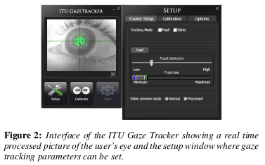
Introduction
Objective: to take inexpensive components and assemble a device capable of taking input from a human i.e. in our case is an eye tracker.
Research at the IT University of Copenhagen has demonstrated viability of corneal reflection gaze tracking on low cost hardware.
From: Evaluation of a Low-Cost Open-Source Gaze Tracker, JS Augustin et. al. [2010]

Slide 3
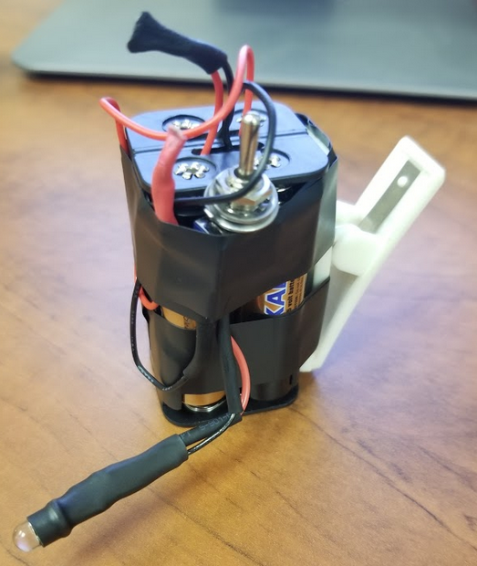
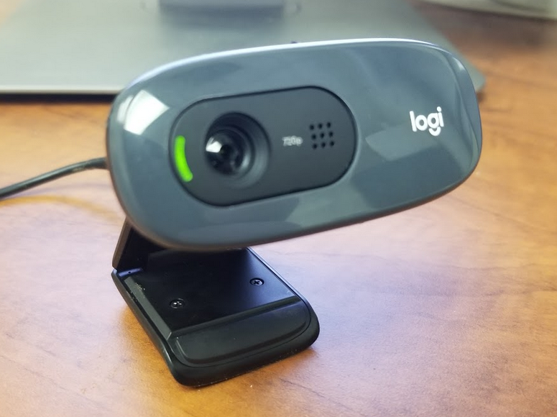
Hardware
IR Emitter : an IR LED 940nm emitter with 6v battery power supply.
IR Filter: developed film, cut to size
Web Camera: a Logitech C270 with i720p resolution.
Chin Rest: a plastic box which is 5” in height.

Slide 4
Software
We used the ITU Gaze Tracker source code with some modifications.
Windows Dell Laptop Inspiron Laptop running Windows 10 and Visual Studio 2019 IDE on the .NET 4.7 framework for modifying and running the source code.
Modified files
Interpolation.cs: correct angle calculation and store average error to CalibrationData object. We also added a calculation of Spatial Precision.
CalibrationSettings.cs: set distance to screen correctly

Slide 5
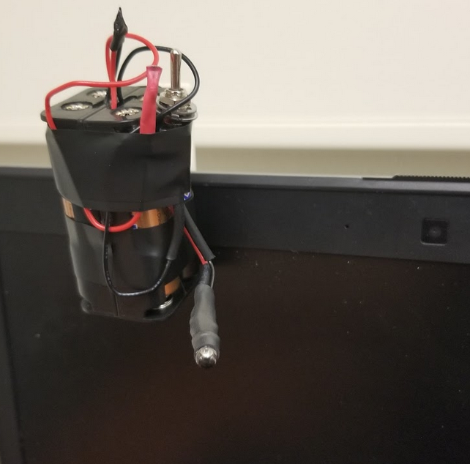
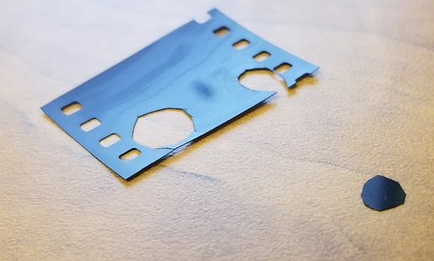
Modifications of the Camera
The visible light filter was removed carefully, and the lens was cleaned to remove debris.
We then cut the IR filter to size fit it to the lens enclosure of the camera.
The IR light was assembled separately and not attached to the camera. This allows testing several light placements.

Slide 6
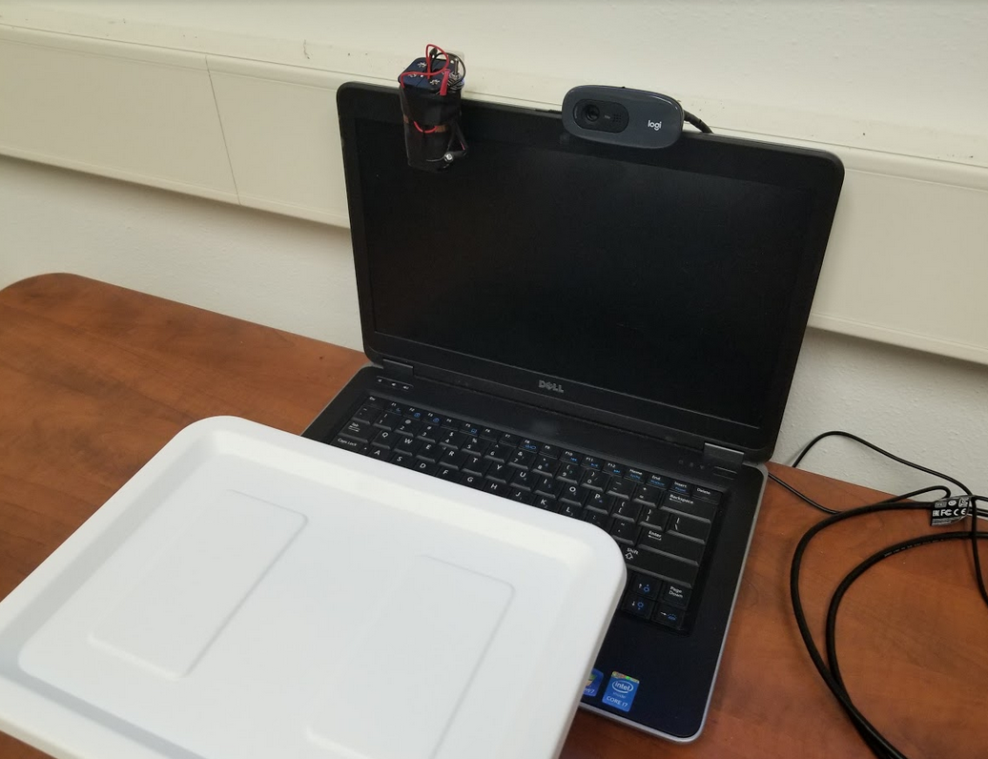
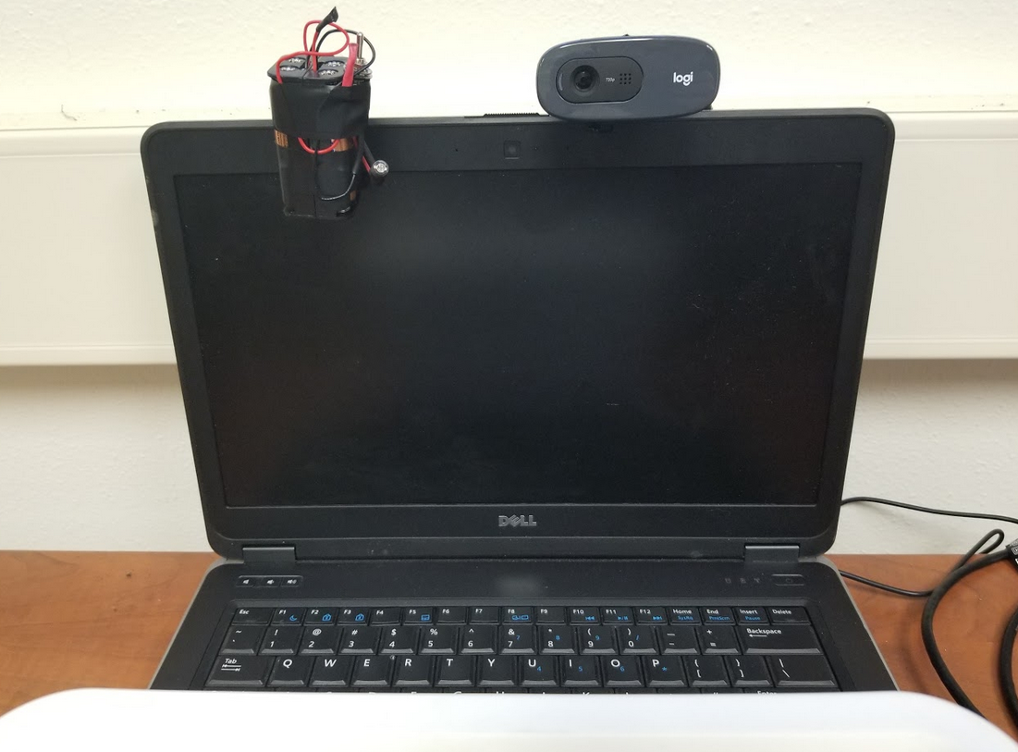
Camera holder and Chin-Rest
The Chin-Rest was made using plastic box of around 5”. This box was positioned to orient the test subject's eye roughly 12" from the screen.
We used the laptop screen as our camera holder and attached it the Web camera on top to place it steadily

Slide 7
Challenges
A Linux-based software suite, MonoDevelop, was tested as a development environment for the software platform but was abandoned in favour of Visual Studio over unsupported UI elements
A low power IR Emitter was chosen over safety concerns but did not caste sufficient light for reliable glint detection. A supplemental light source was added to illuminate the face.
One webcam lens was scratched during the removal of the visible light filter.
Digesting a large, existing code base was necessary before meaningful changes could be made.
Initially two layers of Visible Light filtering film were used based on prior work. This produced images which were much too dark to process.

Slide 8
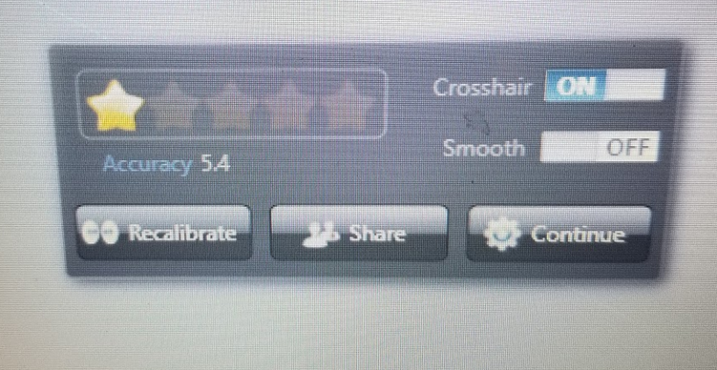
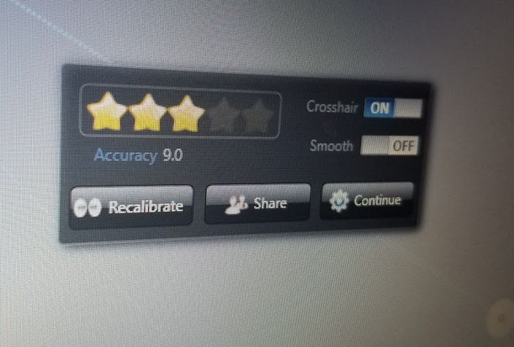
Spatial Accuracy & Precision
Best Accuracy: 5.4 degrees
Best Precision: unkown
Spatial Precision was calculated as the mean of the Calibration Target standard deviations but not reported by the system.
The listed challenges inhibited the performance of the platform, but the team was encouraged to have received any result at all.
Repeated alterations of the camera appear to have degraded its performance over time.

Slide 9
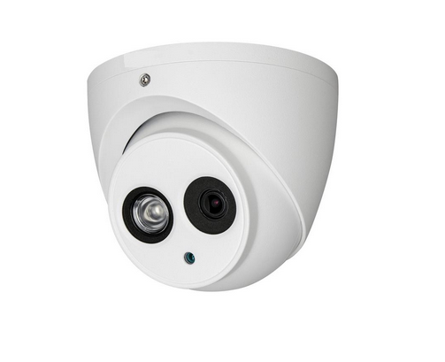
Future Work:
It would be fruitful to work with integrated IR cameras and light sources. Low cost IP security cameras might be a choice.
Other methods of regression might produce a tighter fitting of the sample points to the calibration points, i.e. generalized least squares or itteratively reweighted least squares.
A $65 IR camera/illuminator combination manufactured by SPC.

Slide 10
Conclusions
Low cost eye tracking platforms on commercial hardware are viable.
Co-developing software and hardware is a difficult process.
The provided IR light needs to be powerful enough for illumination, not just creating a reflection.
Further developments of this platform could make eye tracking accessible and widely available.

